Slide 1
22% Less Cake!
Observations of Gender Pay Gap among SF government employees

Slide 2
Women, like men but only 15% cheaper!
Questions:
Where are the pay gaps?
Claim to debunk:
Less women in higher ranking jobs
Less women in work force

Slide 3
Data Collection, Processing and Analysis
Data extracted from kaggle
Download issues
Data cleaning
Used Python to clean and transform it
Used hdfs to store and hive server to import
Analysis
-tableau
-excel
-d3

Slide 4
Data issues
Kaggle login requirement. Solution : CLI browser for linux, lynx Caution : Installation issues, small learning curve
Finding gender for employees. Solution: Python package, sexmachine Caution: Slow processing
Bad data, like caps values, missing values, misspelled titles, negative pays
Creating new columns: level, type and department
Outliers

Slide 5
Creating New Columns
dept_general = [ 'fire', 'account', 'animal', 'educator', 'account', 'airport', 'emergency', 'librar']
police =['police', 'finger', 'toxic', 'forensic', 'med examiner',
'sherif', 'probation', 'sergeant']
transit = ['mta', 'transit', 'trnsp', 'transport', 'fare']
contruction = ['mason', 'const', 'building', 'housing', 'cement', 'civil', 'carpentor', 'materials', 'bricklayer', 'commercial', 'landscape', 'glazier','eqip', 'power', 'civil', 'engineer',
'electric', 'plumber', 'maint', 'repairer', 'weld', 'operat', 'planner', 'bldg', 'parts', 'street']
medical= ['anesth', 'medical', 'nurs', 'clinic', 'health', 'pharm', 'care', 'diagn','chemist', 'lab', 'physic', 'orthopedic', 'Epidemiologist', 'microb', 'dph', 'environ', 'family', 'nutri', 'social', 'pysch', 'radiol', 'therap']
court = ['court', 'legal', 'attorney','hearing','public defender']
municipal = ['mari','sew', 'water', 'wtrt', 'aquatics', 'port', 'industrial', 'asphalt', 'bldg', 'arbor', 'electr', 'line', 'municipal', 'port director','utlity' ]
city = ['city', 'claim', 'community', 'collect', 'commissioner', 'mayor', 'services', 'asses', 'asr', 'benefits', 'eligibility', 'employee', 'events', 'fiscal', 'gov', 'staff', 'media', 'project', 'parking', 'payrol', 'permit', 'property', 'real', 'program',
'rep','rent']

Slide 6
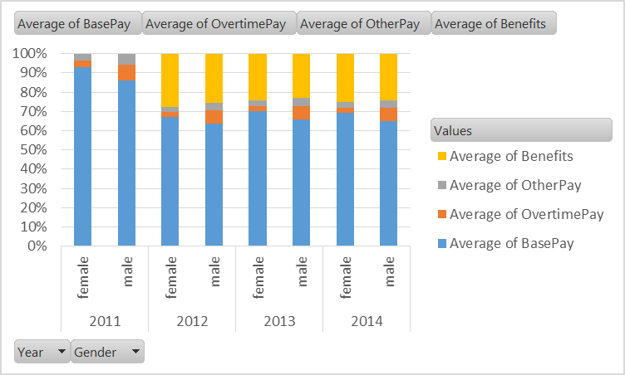
Visualization
Salaries Comparison
Trend in Years
Trend By Job Type

Slide 7
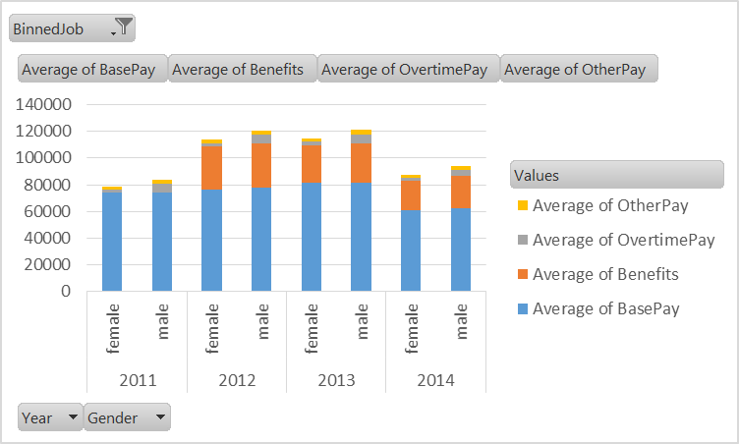
Things I Learned
Be Prepared to Clean the Data!
& Gender Gap is Real

